Slide 1
Word List: naut, naus, nav
= relating to the sea, ships, or travelers

Slide 2
affected with a feeling of sickness in the stomach that feels like sea sickness

Slide 3
nauseous
affected with a feeling of sickness in the stomach that feels like sea sickness

Slide 4
a person who took part in the California Gold Rush by traveling west in search of gold from 1848-1849

Slide 5
Argonaut
a person who took part in the California Gold Rush by traveling west in search of gold from 1848-1849

Slide 6
wide or deep enough for ships to be able to pass through

Slide 7
navigable
wide or deep enough for ships to be able to pass through

Slide 8
related to sailing, sailors, or ships

Slide 9
nautical
related to sailing, sailors, or ships

Slide 10
a person who is trained to travel into outer space

Slide 11
astronaut
a person who is trained to travel into outer space

Slide 12
to steer or direct a ship or airplane

Slide 13
navigate
to steer or direct a ship or airplane

Slide 14
to travel around the earth on water or in the air

Slide 15
circumnavigate
to travel around the earth on water or in the air

Slide 16
a Soviet who is trained to travel into outer space

Slide 17
cosmonaut
a Soviet who is trained to travel into outer space

Slide 18
A Soviet was a person from the Soviet Union. The Soviet Union is no longer in existence. Currently, Russia is the largest country of the former Soviet Union.

Slide 19
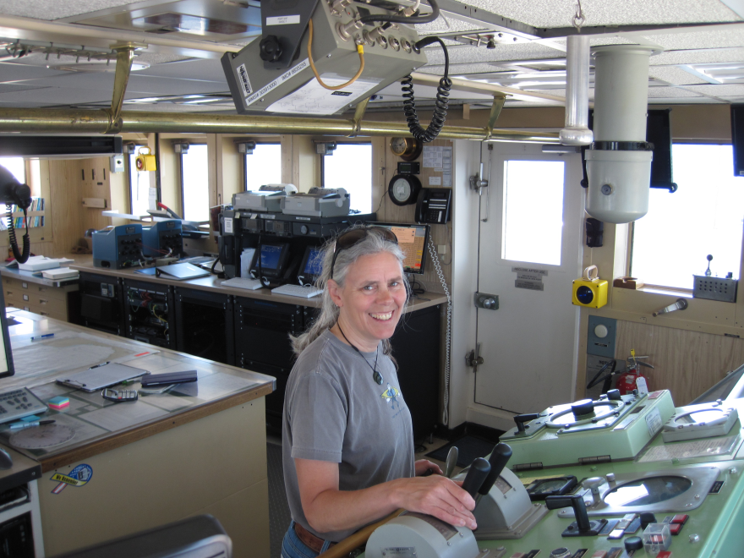
a person who is trained to plan the course of and drive a ship

Slide 20
navigator
a person who is trained to plan the course of and drive a ship

Slide 21
a fleet of ships; all the warships of a nation

Slide 22
navy
a fleet of ships; all the warships of a nation

